Slide 1
3D Printed Quad copter Drone
By: Josiah Bennett

Slide 2
Why am I credible?
Research
Experience
Product

Slide 3
My Goals
Project Description
Ghantt Chart
Highlights
Lowlights
Lessons Learned
Worth doing differently
Demo
Conclusion

Slide 4
Project Description
Build a quad copter drone
3D printed Chassis
Camera capability

Slide 5
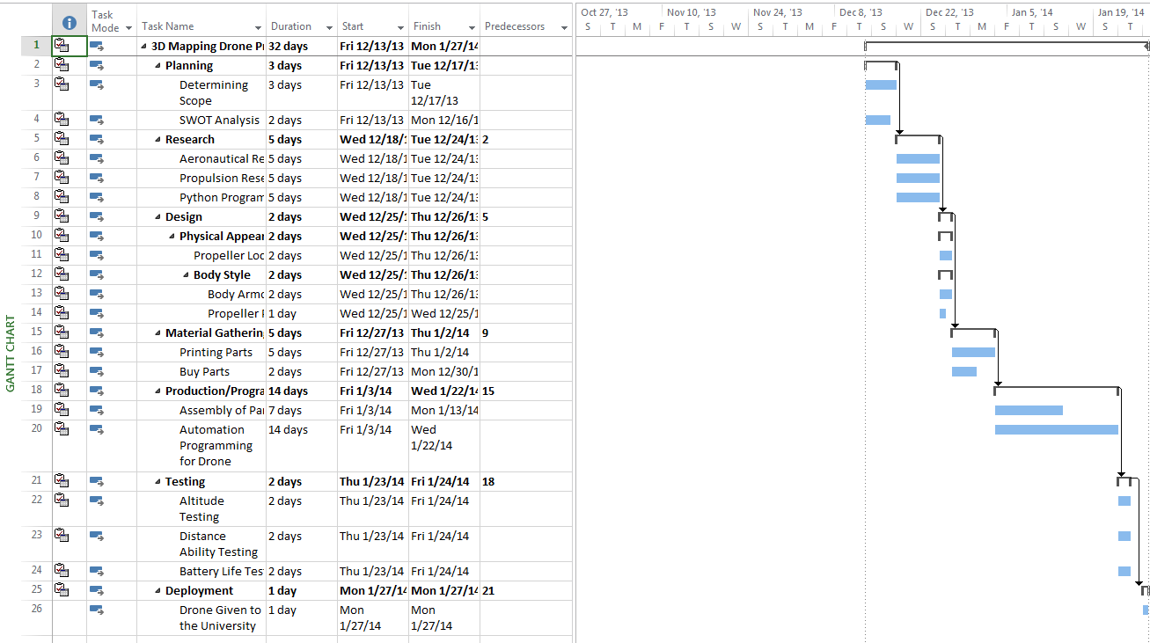
Project Ghantt Chart

Slide 6
Highlights
Electronics
3D Printing
Wiring Practice

Slide 7
Lowlights
Health issues
Wiring issues
3D Printer Problems
Chassis print problems

Slide 8
Lowlights
GPS Problems
Compass Problems
Power Problems

Slide 9
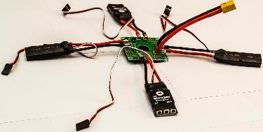
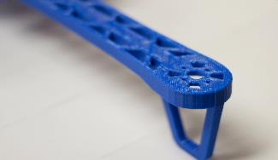
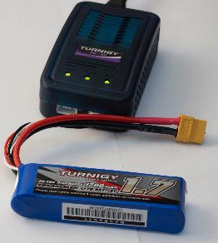
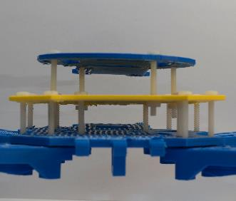
Production

Slide 10
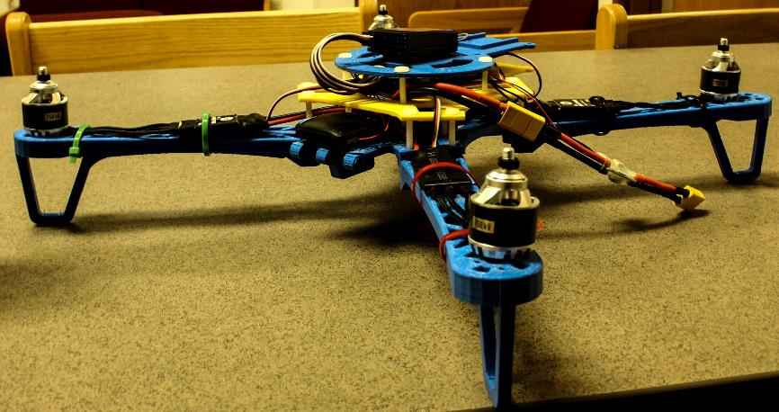
Finished Product

Slide 11
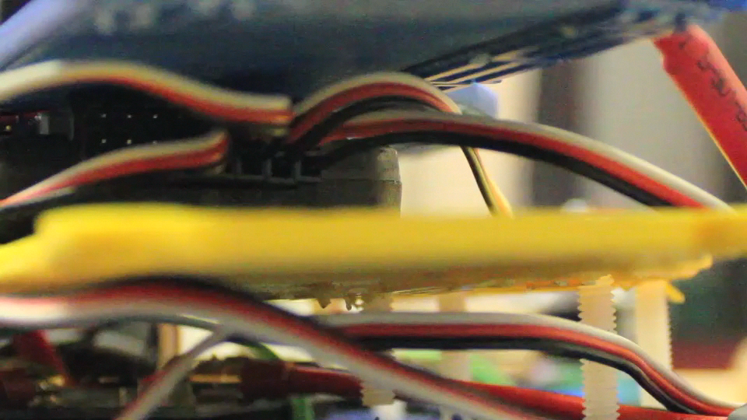
Startup Sequence

Slide 12
Worth Doing Differently
Metal Chassis vs. 3D Printed Chassis
Larger Chassis
Kit vs. Individual Parts

Slide 13
Demonstration

Slide 14
Concluding Remarks
3D Printing Advances
Drone Technology Availability
Project Benefits

Slide 15
Capstone Blog and Resume
Capstone Blog

Slide 16
Questions?

Slide 17
Special Mentions
CTM and CIST Faculty
http://diydrones.com
http://planner.ardupilot.com/
http://www.flysky-cn.com/eProducts1.asp
https://www.makerbot.com/

Slide 18
Thank You!

